Slide 1
Tumors of the bone II

Slide 2
WHO classification of bone tumors
I- Primary bone tumors:
Oteogenic tumors: osteoid osteoma, osteoblastoma, osteosarcoma.
Chondrogenic tumors: osteochondroma, chondroma, chondroblastoma, chondrosarcoma.
Fibrogenic tumors: fibroma, fibrosarcoma.
Tumors of unknown origin: gianit cell tumor, adamantenoma, Ewing’s tumor.

Slide 3
5- haematopoitic tumors: leukaemia, lymphoma, MM.
6- lipogenic tumors: lipoma, liposarcoma.
7- Vascular: haemangioma.
8- Neurogenic tumor: neurofibroma.
9- Notochordal tumor: chordoma.
10- Histeocytic tumors: fibrous histeocytoma.

Slide 4
II- secondary tumors of the bone: metastasis.

Slide 5
Locally malignant tumors
Osteoclastoma

Slide 6
Occurs in skeletally mature adults (20:40 years).
Epiphysis of long bone.
Grossly: egg shell crackling sensation.
Microscopically: dual composition of small mononuclear and multinucleated osteoclast-like giant cells.

Slide 7
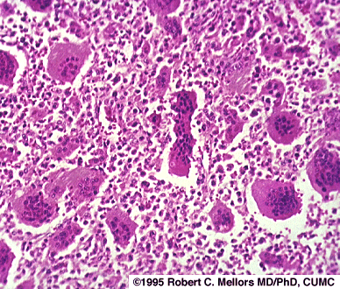

Slide 8
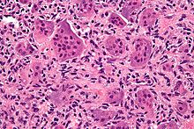

Slide 9
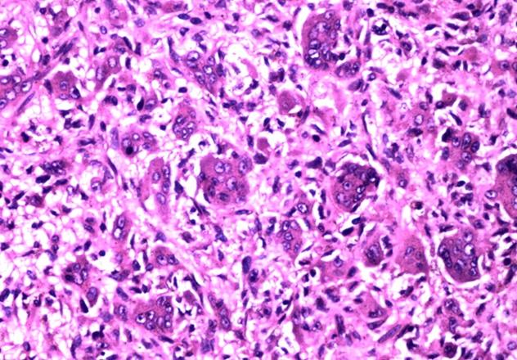

Slide 10
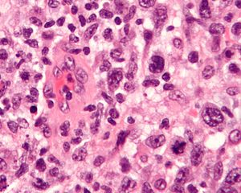

Slide 11
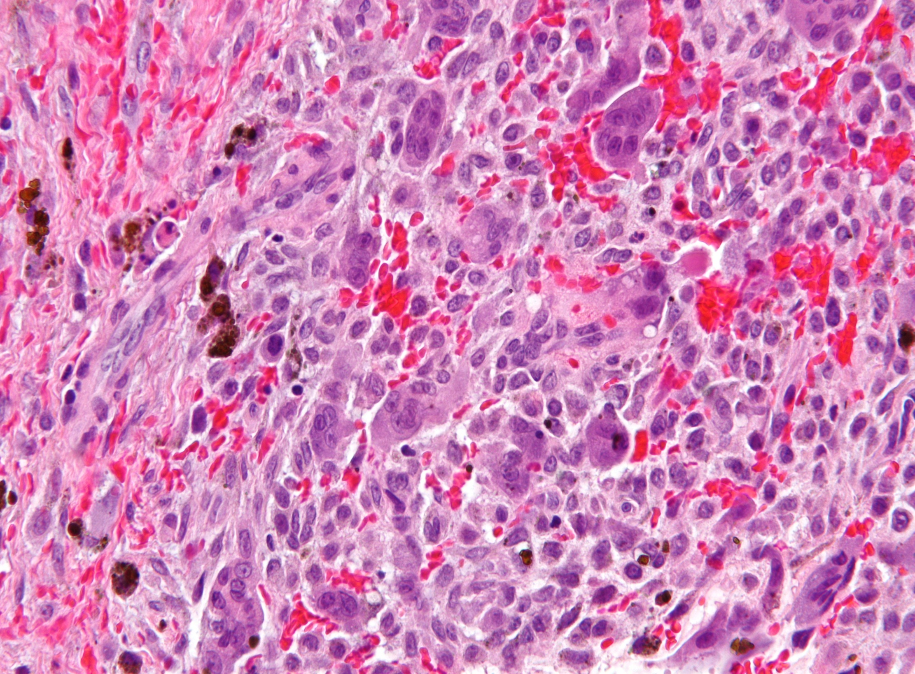

Slide 12
Malignant tumors
Osteosarcoma

Slide 13
Osteosarcoma
Most common and most aggressive bone neoplasm.
10-25 years, slight male predominance.
Radiologically: sun rays appearance, codman triangle.

Slide 14
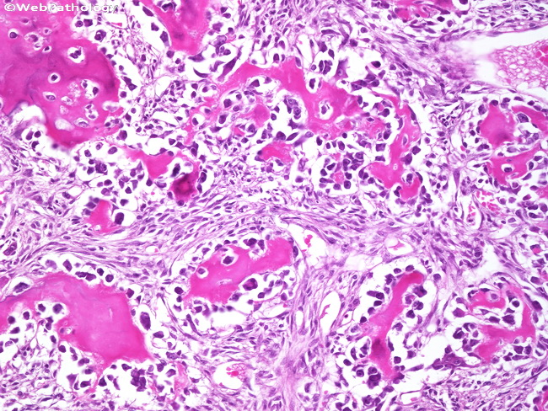

Slide 15
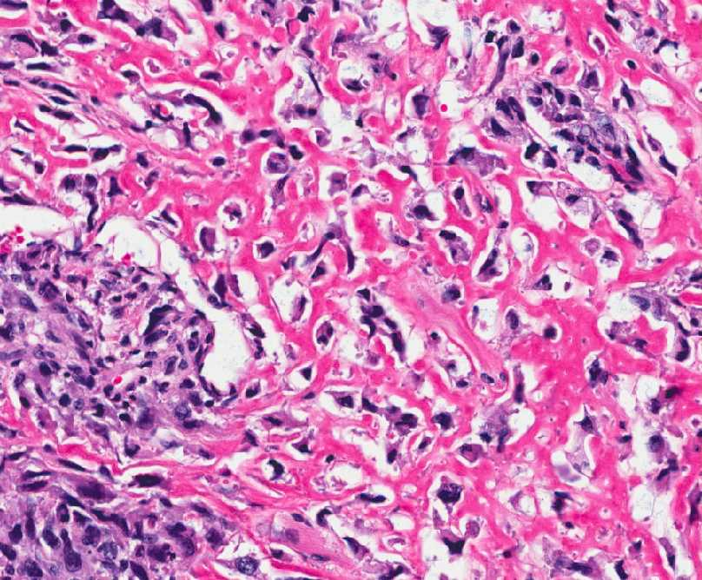

Slide 16
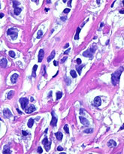

Slide 17
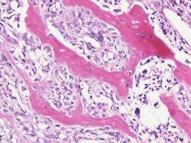

Slide 18
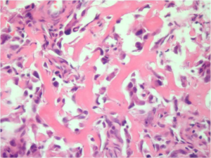

Slide 19
Chondrosarcoma

Slide 20
Chondrosarcoma
Arise in flat bone,pelvis, sternum, scapula, ribs, inaddition to long bone.
30-60 years. Slight male predominance.

Slide 21
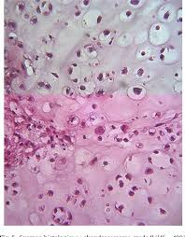

Slide 22
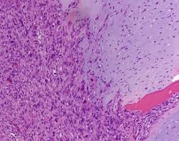

Slide 23
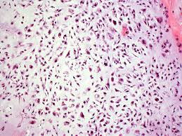

Slide 24
